Slide 1

Development of a Bus System for the University of North Alabama
By: Olivia Sharpston, Christian Miller, Nolen Robinson, and Jacobe Johnson
Professor: Dr. Ron Davis
April 30, 2025

Slide 2

Outline:
Olivia Sharpston, Christian Miller, Nolen Robinson, Jacobe Johnson
Problem Statement
Feasibility Study
Brief Review of Requirements Analysis and Specification
Preliminary Design
Detailed Design
Project Management
Mockup of Prototype
Conclusion

Slide 3
Problem Statement
Olivia Sharpston, Christian Miller, Nolen Robinson, Jacobe Johnson
The University of North Alabama Transportation
Not an efficient way of transportation around campus
‘Lion’s Lift’ ended in August 2023
Current campus transportation information known information is outdated
‘Slidr’ is an outdated and no longer used service
Limited parking near campus
Time gap between classes is typically 10 to 15 minutes
May be difficult if class is completely across campus

Slide 4
Feasibility Study
Olivia Sharpston, Christian Miller, Nolen Robinson, Jacobe Johnson
This would be economically feasible
Many students do not have a way of transportation
Will likely increase with current economy
Would lead to higher rate of public transportation
Bus system would be ran by the University of North Alabama
Becomes a safer way of transportation for students

Slide 5
Brief Review of Requirements Analysis and Specification
Olivia Sharpston, Christian Miller, Nolen Robinson, Jacobe Johnson
Functional Requirements
Shall creates wait time for buses
Shall does not bring in data from 17:00 CST to 6:00 CST
Shall call location API every sixty seconds
Shall integrate with back-end system
Operational Requirements
Should not be more than $35,000 U.S. dollars to develop
Should not cost more than $5,000 U.S. dollars per year to operate

Slide 6
Brief Review of Requirements Analysis and Specification
Olivia Sharpston, Christian Miller, Nolen Robinson, Jacobe Johnson
Maintenance and Support Requirements
Shall have an annual uptime of 95%
Downtime average of 18.25 days
Shall automatically checks for necessary updates daily
Shall automatically download and install required updates
Shall not cost for than $ 20,000 U.S. dollars to dispose
Other Specifications
The UNA Transportation I.T. Specialists maintain the system
The system is started by the shuttle bus driver

Slide 7
GPS Subsystem and Other Specifications
Olivia Sharpston, Christian Miller, Nolen Robinson, Jacobe Johnson
Who uses the system?
Students, faculty, a GPS receiver program on the internet, and the end user’s device
Who installs the GPS subsystem?
The system is web based but has a local installation on the shuttles’ GPS transmitter
What other systems interface with the system?
GPS transmitter hardware, shuttles’ localized network, online-hosted GPS system, and end user’s device (where it is displayed)

Slide 8
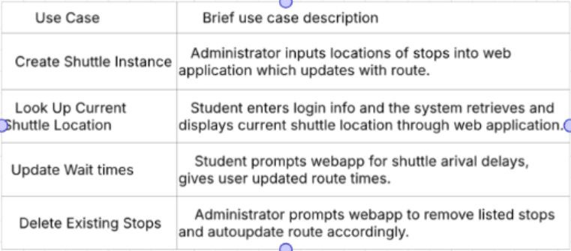
Use Cases
Olivia Sharpston, Christian Miller, Nolen Robinson, Jacobe Johnson

Slide 9
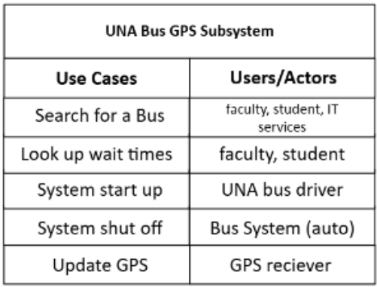
Actors for the System
Olivia Sharpston, Christian Miller, Nolen Robinson, Jacobe Johnson
Determining the actors allows the relationship between the use cases and who is involved to be seen. Furthermore, this enhances the understand of how each actor correlates with a use case situation.

Slide 10
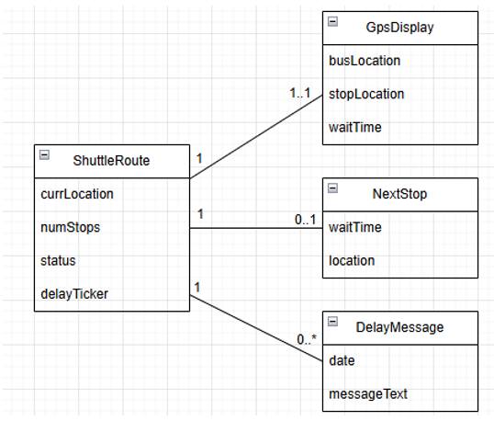
Domain Class Model
Olivia Sharpston, Christian Miller, Nolen Robinson, Jacobe Johnson
By using a domain class model diagram, it is easier to see the relationships between the objects involved in the system.

Slide 11
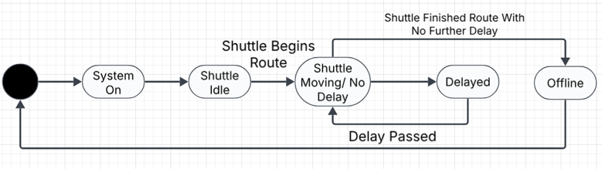
State Machine Diagram
Olivia Sharpston, Christian Miller, Nolen Robinson, Jacobe Johnson
The state machine diagram helps visualize the different states that the system can be in. Additionally, this shows the relationship between each state.

Slide 12
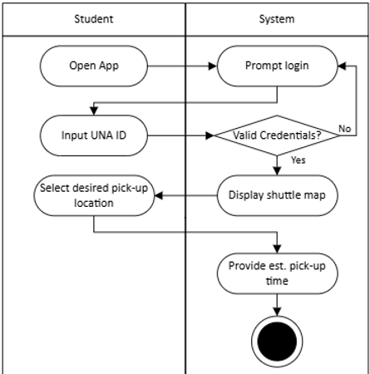
Activity Diagram
Olivia Sharpston, Christian Miller, Nolen Robinson, Jacobe Johnson
The activity diagram is to help visualize the flow of activities in the system presented. The flow of direction is shown with the arrows.

Slide 13
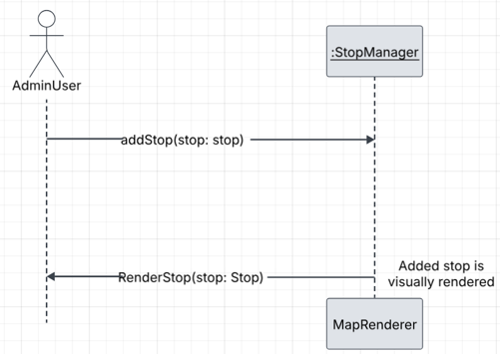
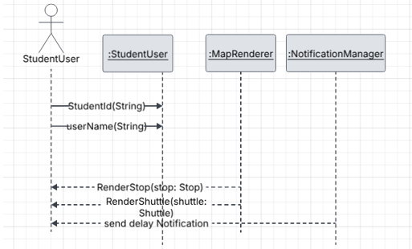
System Sequence Diagram for Admins and Students
Olivia Sharpston, Christian Miller, Nolen Robinson, Jacobe Johnson
Student Sequence Diagram
Admin Sequence Diagram

Slide 14
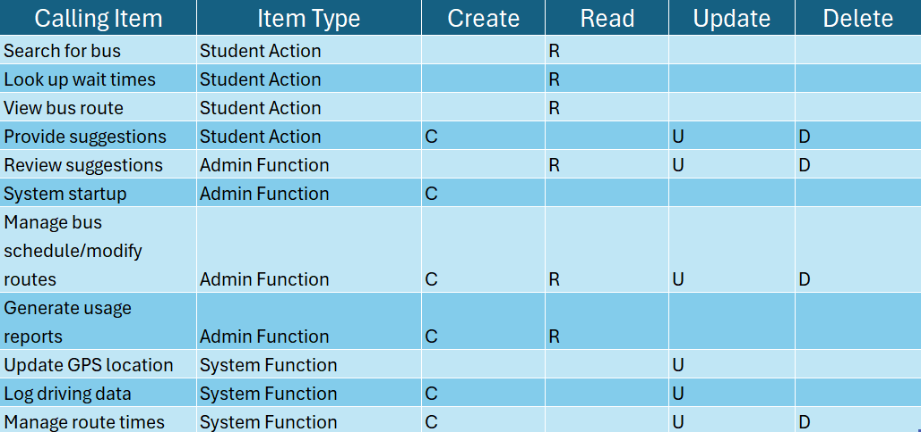
CRUD Matrix
Olivia Sharpston, Christian Miller, Nolen Robinson, Jacobe Johnson
The CRUD matrix helps visualize the activities and permissions within a system.
C -> Create
R -> Read
U -> Update
D -> Delete

Slide 15
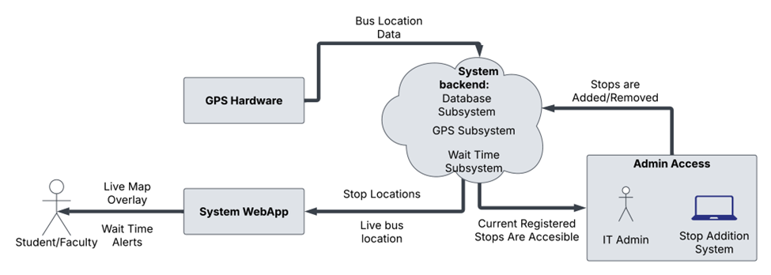
System of Interest
Olivia Sharpston, Christian Miller, Nolen Robinson, Jacobe Johnson

Slide 16
Preliminary Design
Olivia Sharpston, Christian Miller, Nolen Robinson, Jacobe Johnson
Environment Description
Relevant stakeholders: students, faculty, UNA I.T. department, and bus driver(s)
Students/Faculty: need to expect reliable, easy-to-use, and efficient way of transportations
UNA I.T. Department: conduct maintenance for the GPS hardware and system application
Bus Driver(s): effectively transport passengers and handle the system on the bus(es)

Slide 17
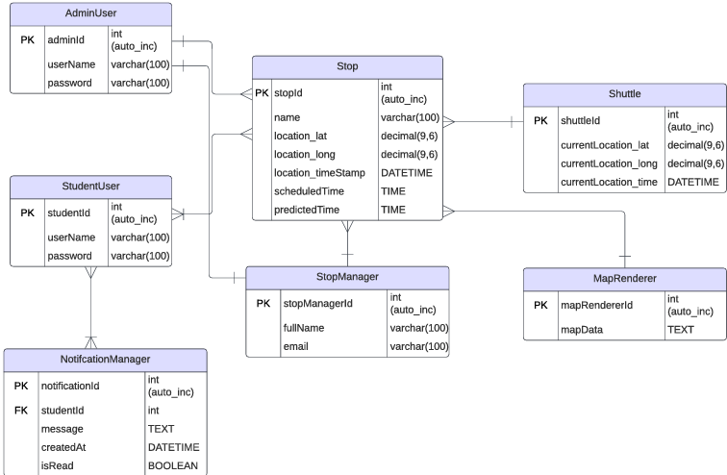
Database Design
Olivia Sharpston, Christian Miller, Nolen Robinson, Jacobe Johnson

Slide 18
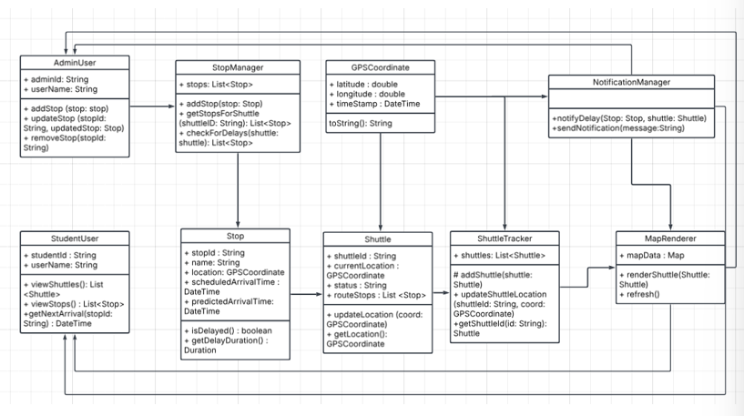
Software Classes and Methods
Olivia Sharpston, Christian Miller, Nolen Robinson, Jacobe Johnson

Slide 19
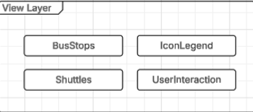
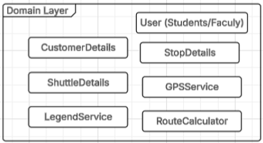
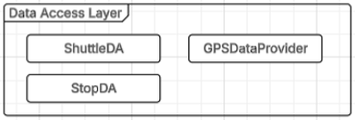
Application Components
Package Diagram
Olivia Sharpston, Christian Miller, Nolen Robinson, Jacobe Johnson

Slide 20
Design Application Component Description
Olivia Sharpston, Christian Miller, Nolen Robinson, Jacobe Johnson
Key Components:
User browser
Smartphones
Hosts UI
Business Logic Components
Central Databases
Used for shuttle(s), users, and GPS data
Possible bought products include:
GPS data provider, map and route services, authentication system, and application hosting

Slide 21
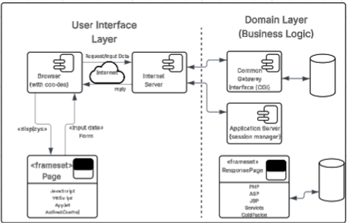
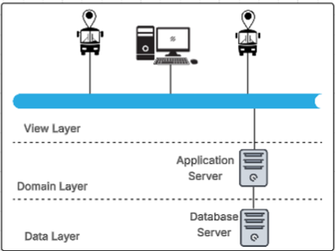
Application Components
Component and Deployment Diagrams
Olivia Sharpston, Christian Miller, Nolen Robinson, Jacobe Johnson
Deployment Diagram
Component Diagram

Slide 22

Project Management:
Net Present Value
Olivia Sharpston, Christian Miller, Nolen Robinson, Jacobe Johnson
Net present value (NPV) charts helps a team be able to visualize whether their project or system will be profitable over time.

Slide 23
Project Management:
Payback Period
Olivia Sharpston, Christian Miller, Nolen Robinson, Jacobe Johnson
A payback period chart represents how quickly a project or system will recover from the initial costs.

Slide 24
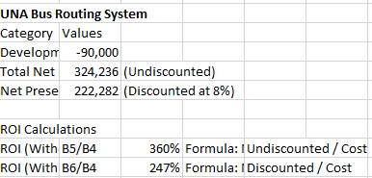
Project Management:
Return On Investment Calculations
Olivia Sharpston, Christian Miller, Nolen Robinson, Jacobe Johnson
Return on Investment (ROI) charts help to visualize the profit on systems and projects. This can help a team monitor the performance of their system or project.

Slide 25
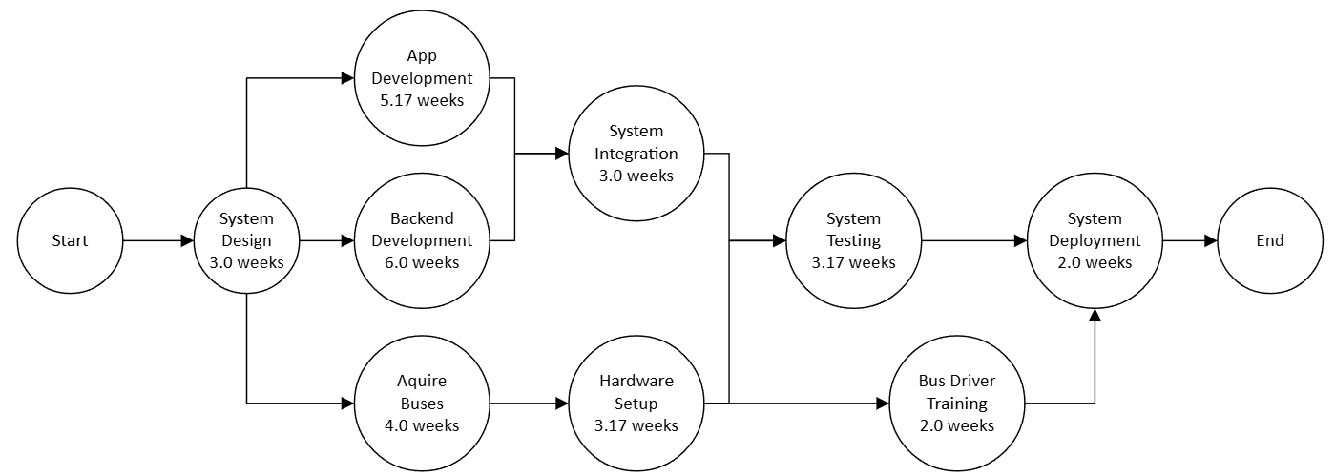
Project Management:
PERT Chart
Olivia Sharpston, Christian Miller, Nolen Robinson, Jacobe Johnson
A PERT chart is to help the project team organize their tasks within a project with a timeline.
For this PERT, the critical path starts with the backend development.

Slide 26
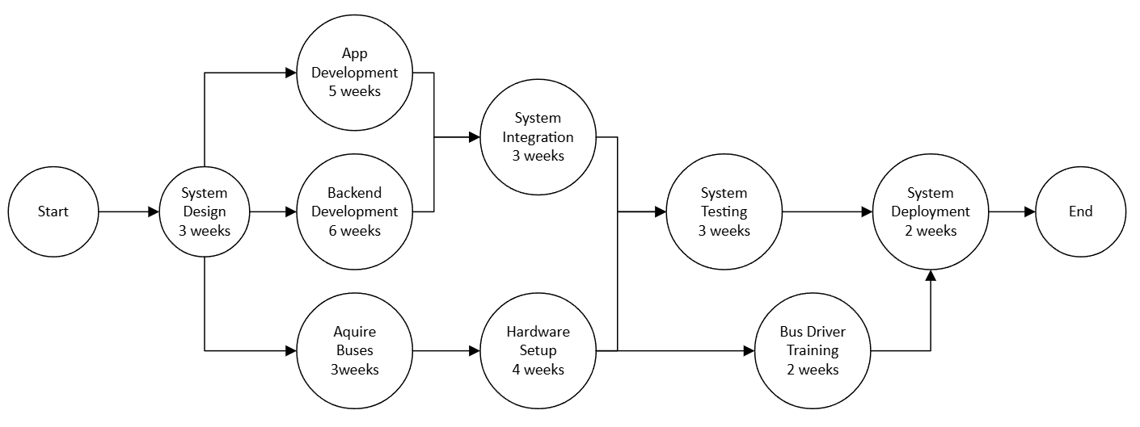
Project Management:
CPM Chart
Olivia Sharpston, Christian Miller, Nolen Robinson, Jacobe Johnson
While very similar, CPM charts have a more fixed time estimate than a PERT chart. The critical path is still the same as the PERT as it defines the minimum time required to finish the project.

Slide 27
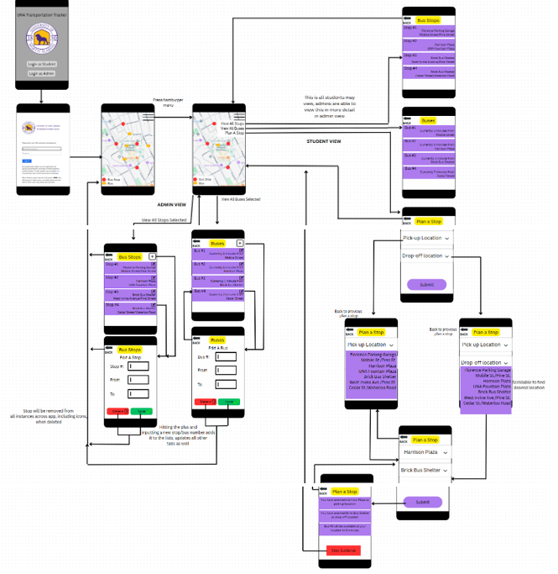
Mockup of Prototype
Olivia Sharpston, Christian Miller, Nolen Robinson, Jacobe Johnson
Left side shows the admin’s view of their allowed tools
Right side shows what the user will see
Lower-right shows what it is like to create a stop

Slide 28
Conclusion
Olivia Sharpston, Christian Miller, Nolen Robinson, Jacobe Johnson
Goal: To create an efficient and effective way of transportation for the students and faculty around the University of North Alabama
Future Work: To monitor the amount of use from the shuttles and continue to manage the maintenance.
Lesson Learned: Designing and setting up a system requires more diagrams than imagined.
Lesson Learned: It is important to get user feedback throughout the process so that improvements can be made for user satisfaction.

